Slide 1
Risk Management: Assessing and Controlling Risk
Chapter 5
If this is the information superhighway, it’s going through a lot of bad, bad, neighborhoods.
-- DORIAN BERGER, 1997

Slide 2
Learning Objectives:
Upon completion of this chapter you should be able to:
  Recognize why risk control is needed in today’s organizations
  Know the risk mitigation strategy options for controlling risks
  Identify the categories that can be used to classify controls
  Be aware of the conceptual frameworks that exist for evaluating risk controls, and be able to formulate a cost benefit analysis when required
  Understand how to maintain and perpetuate risk controls
Principles of Information Security - Chapter 5
Slide <number>

Slide 3
Risk Management
Risk management is the process of identifying vulnerabilities in an organization’s information systems and taking carefully reasoned steps to assure the confidentiality, integrity, and availability of all the components in the organization’s information systems
The primary deliverable from risk assessment was a list of documented vulnerabilities, ranked by criticality of impact
Principles of Information Security - Chapter 5
Slide <number>
Notes:
Introduction
Competitive advantage vs. competitive disadvantage, or the need to avoid falling behind the competition
To keep up with the competition, organizations must design and create a safe environment in which business processes and procedures can function
This environment must maintain the confidentiality, privacy and integrity of organizational data
These objectives are met through the application of the principles of risk management
Risk Management
Risk management is the process of identifying vulnerabilities in an organization’s information systems and taking carefully reasoned steps to assure the confidentiality, integrity, and availability of all the components in the organization’s information system.
The primary deliverable from risk assessment was a list of documented vulnerabilities, ranked by criticality of impact.
Here, you work from that list, assessing options, estimating costs, weighing relative merits of options, and gauging the benefits from various control approaches.

Slide 4
Risk Control Strategies
When risks from information security threats are creating a competitive disadvantage, the information technology and information security communities of interest take control of the risks
Four basic strategies are used to control the risks that result from vulnerabilities:
  Apply safeguards (avoidance)
  Transfer the risk (transference)
  Reduce the impact (mitigation)
  Inform themselves of all of the consequences and accept the risk without control or mitigation (acceptance)
Principles of Information Security - Chapter 5
Slide <number>
Notes:
RISK CONTROL STRATEGIES
When organizational management has determined that risks from information security threats are creating a competitive disadvantage, they empower the information technology and information security communities of interest to control the risks.
Once the project team for information security development has created the Ranked Vulnerability Worksheet, the team must choose one of four basic strategies to control the risks that result from these vulnerabilities.
The four risk strategies guide an organization to:
1. Apply safeguards that eliminate or reduce the remaining uncontrolled risks for the vulnerability (avoidance)
2. Transfer the risk to other areas or to outside entities (transference)
3. Reduce the impact should the vulnerability be exploited (mitigation)
4. Inform themselves of all of the consequences and accept the risk without control or mitigation (acceptance)

Slide 5
Avoidance
Avoidance attempts to prevent the exploitation of the vulnerability
This is the preferred approach, as it seeks to avoid risk in its entirety rather than dealing with it after it has been realized
Accomplished through countering threats, removing vulnerabilities in assets, limiting access to assets, and/or adding protective safeguards
Three areas of control:
  Policy
  Training and education
  Technology
Principles of Information Security - Chapter 5
Slide <number>
Notes:
Avoidance
Avoidance is the risk control strategy that attempts to prevent the realization or exploitation of the vulnerability. This is the preferred approach, as it seeks to avoid risk in its entirety rather than dealing with it after it has been realized.
Avoidance is accomplished through countering threats, removing vulnerabilities in assets, limiting access to assets, and/or adding protective safeguards.
The most common methods of avoidance involve three areas of controls, avoidance through application of policy, training and education, and technology.

Slide 6
Transference
Transference is the control approach that attempts to shift the risk to other assets, other processes, or other organizations
If an organization does not already have quality security management and administration experience, it should hire individuals or firms that provide such expertise
This allows the organization to transfer the risk associated with the management of these complex systems to another organization with established experience in dealing with those risks
Principles of Information Security - Chapter 5
Slide <number>
Notes:
Transference
Transference is the control approach that attempts to shift the risk to other assets, other processes, or other organizations.
If an organization does not already have quality security management and administration experience, it should hire individuals or firms that provide such expertise.
This allows the organization to transfer the risk associated with the management of these complex systems to another organization with established experience in dealing with those risks.

Slide 7
Mitigation
Mitigation attempts to reduce the impact of exploitation through planning and preparation
Three types of plans:
  disaster recovery planning (DRP)
  business continuity planning (BCP)
  incident response planning (IRP)
The most common of the mitigation procedures is the disaster recovery plan or DRP
The actions to take while the incident is in progress are defined in the incident response plan or IRP
Longer term issues are handled in the business continuity plan or BCP
Principles of Information Security - Chapter 5
Slide <number>
Notes:
Mitigation
Mitigation is the control approach that attempts to reduce the impact caused by the exploitation of vulnerability through planning and preparation.
This approach includes three types of plans: disaster recovery planning (DRP), business continuity planning (BCP), and incident response planning (IRP).
Mitigation begins with the early detection that an attack is in progress.
The most common of the mitigation procedures is the disaster recovery plan.
The DRP includes the entire spectrum of activities to recover from an incident. The DRP can include strategies to limit losses before and during the disaster.
DRPs usually include all preparations for the recovery process, strategies to limit losses during the disaster, and detailed steps to follow when the disaster has ended.
The actions an organization can and perhaps should take while the incident is in progress should be defined in a document referred to as the incident response plan or IRP.
The IRP provides answers to questions victims might pose in the midst of a disaster.
It answers the questions:
What do I do NOW?!
What should the administrators do first?
Who should they contact?
What should they document?
DRP and IRP planning overlap to a degree. In many regards, the DRP is the subsection of the IRP that covers disastrous events.
While some DRP and IRP decisions and actions are the same, their urgency and results can differ dramatically.
The DRP focuses more on preparations completed before and actions taken after the incident, while the IRP focuses on intelligence gathering, information analysis, coordinated decision making and urgent, concrete actions.
The third type of planning document under mitigation is the business continuity plan or BCP.
The BCP is most strategic and long-term plan of the three plans. It encompasses the continuation of business activities if a catastrophic event occurs, such as the loss of an entire database, building or operations center.
The BCP includes planning for the steps to insure the continuation of the organization when the scope or scale of a disaster exceeds the DRPs ability to restore operations.

Slide 8
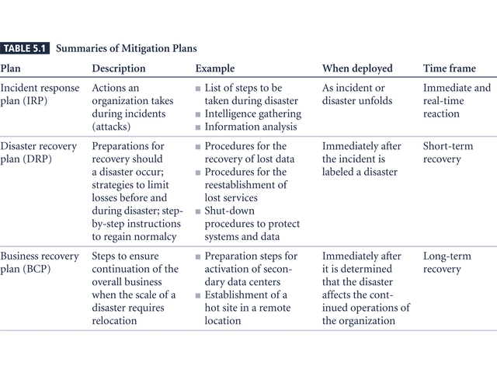
Table 5-1 – Mitigation Summary
Principles of Information Security - Chapter 5
Slide <number>

Slide 9
Acceptance
Acceptance of risk is doing nothing to close a vulnerability and to accept the outcome of its exploitation
Acceptance is valid only when:
  Determined the level of risk
  Assessed the probability of attack
  Estimated the potential damage
  Performed a thorough cost benefit analysis
  Evaluated controls using each appropriate feasibility
  Decided that the particular function, service, information, or asset did not justify the cost of protection
Risk appetite describes the degree to which an organization is willing to accept risk as a trade-off to the expense of applying controls
Principles of Information Security - Chapter 5
Slide <number>
Notes:
Acceptance
With the Acceptance control approach, an organization evaluates the risk of a vulnerability and allows the risky state to continue as is.
The only acceptance strategy that is recognized as valid occurs when the organization has:
Determined the level of risk
Assessed the probability of attack
Estimated the potential damage that could occur from these attacks
Performed a thorough cost benefit analysis
Evaluated controls using each appropriate type of feasibility
Decided that the particular function, service, information, or asset did not justify the cost of protection
Acceptance of risk is the choice to do nothing to protect a vulnerability and to accept the outcome of its exploitation.
This control, or rather lack of control, is based on the assumption that it may be a prudent business decision to examine the alternatives and determine that the cost of protecting an asset does not justify the security expenditure.
The term, risk appetite is used to describe the degree to which an organization is willing to accept risk as a trade-off to the expense of applying controls.

Slide 10
Mitigation Strategy Selection
The level of threat and value of the asset play a major role in the selection of strategy
The following rules of thumb can be applied in selecting the preferred strategy:
  When a vulnerability can be exploited, apply layered protections, architectural designs, and administrative controls to minimize the risk or prevent this occurrence
  When the attacker’s cost is less than his/her potential gain apply protections to increase the attacker’s cost
  When potential loss is substantial, apply design principles, architectural designs, and technical and non-technical protections to limit the extent of the attack, thereby reducing the potential for loss
Principles of Information Security - Chapter 5
Slide <number>
Notes:
Mitigation Strategy Selection
The level of threat and value of the asset should play a major role in the selection of strategy.
The following rules of thumb can be applied in selecting the preferred strategy:
When a vulnerability exists implement assurance techniques to reduce the likelihood of a vulnerability’s being exercised.
When a vulnerability can be exploited apply layered protections, architectural designs, and administrative controls to minimize the risk or prevent this occurrence.
When the attacker’s cost is less than his potential gain apply protections to increase the attacker’s cost (e.g., use system controls to limit what a system user can access and do, thereby significantly reducing an attacker’s gain).
When potential loss is substantial apply design principles, architectural designs, and technical and non-technical protections to limit the extent of the attack, thereby reducing the potential for loss.”

Slide 11
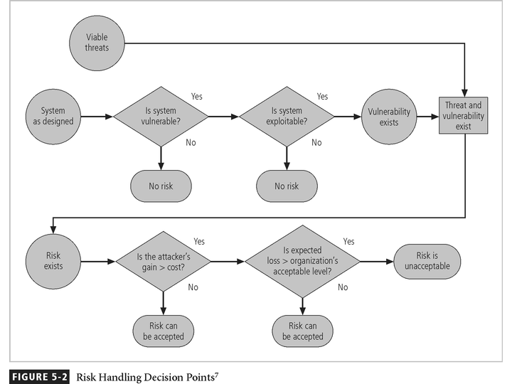
Figure 5-2 - Risk Handling Decision Points
Principles of Information Security - Chapter 5
Slide <number>

Slide 12
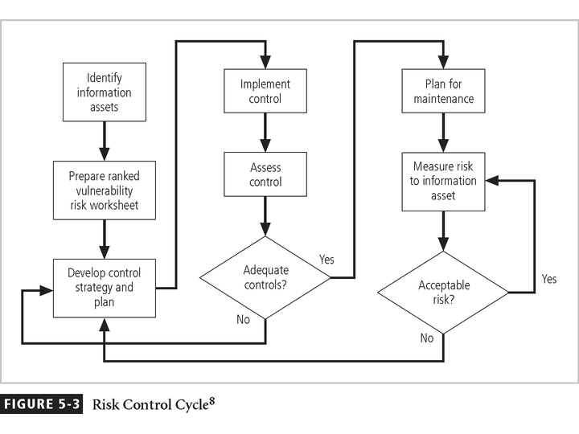
Principles of Information Security - Chapter 5
Slide <number>

Slide 13
Categories of controls
Controlling risk through avoidance, mitigation, or transference may be accomplished by implementing controls or safeguards
One approach to selecting controls is by category:
  Control Function
  Architectural Layer
  Strategy Layer
  Information Security Principles
Principles of Information Security - Chapter 5
Slide <number>
Notes:
Categories of controls
Controlling risk through avoidance, mitigation or transference may be accomplished by implementing controls or safeguards.
One approach to selecting controls is by category:
1. Control Function
2. Architectural Layer
3. Strategy Layer
4. Information Security Principle

Slide 14
Control Function
Controls or safeguards designed to defend the vulnerability are either preventive or detective
Preventive controls stop attempts to exploit vulnerability by implementing enforcement of an organizational policy or a security principle, such as authentication or confidentiality
Detective controls warn of violations of security principles, organizational policies, or attempts to exploit vulnerabilities
Detective controls use techniques such as audit trails, intrusion detection, or configuration monitoring
Principles of Information Security - Chapter 5
Slide <number>
Notes:
Control Function
Controls or safeguards designed to defend the vulnerability are either preventive or detective.
Preventive controls stop attempts to exploit vulnerability by implementing enforcement of an organizational policy or a security principle, such as authentication or confidentiality.
Detective controls warn of violations of security principles, organizational policies, or attempts to exploit vulnerabilities. Detective controls use techniques such as audit trails, intrusion detection, or configuration monitoring.

Slide 15
Architectural Layer
Some controls apply to one or more layers of an organization’s technical architecture
Among the architectural layer designators in common use are:
  organizational policy
  external networks
  extranets (or demilitarized zones)
  Intranets (WAN and LAN)
  network devices that interface network zones (switches, routers, firewalls, and hubs)
  systems (computers for mainframe, server or desktop use)
  applications
Principles of Information Security - Chapter 5
Slide <number>
Notes:
Architectural Layer
Some controls apply to one or more layers of an organization’s technical architecture.
Among the architectural layer designators in common use are: organizational policy, external networks, extranets (or demilitarized zones), Intranets (WAN and LAN), network devices that interface network zones (switches, routers, firewalls, and hubs), systems, (computers for mainframe, server or desktop use) and applications.

Slide 16
Strategy Layer
Controls are sometimes classified by the risk control strategy they operate within:
  avoidance
  mitigation
  transference
Principles of Information Security - Chapter 5
Slide <number>
Notes:
Strategy Layer
Controls are sometimes classified by the risk control strategy they operate within:
avoidance,
mitigation,
transference or
acceptance.

Slide 17
Information Security Principles
Controls operate within one or more of the commonly accepted information security principles:
  Confidentiality
  Integrity
  Availability
  Authentication
  Authorization
  Accountability
  Privacy
Principles of Information Security - Chapter 5
Slide <number>
Notes:
Information Security Principle
Controls operate within one or more of the commonly accepted information security principles:
Confidentiality
Integrity
Availability
Authentication
Authorization
Accountability
Privacy

Slide 18
Feasibility Studies and the Cost Benefit Analysis
Before deciding on the strategy for a specific vulnerability all information about the economic and non-economic consequences of the vulnerability facing the information asset must be explored
Fundamentally we are asking -
“What are the actual and perceived advantages of implementing a control contrasted with the actual and perceived disadvantages of implementing the control?”
Principles of Information Security - Chapter 5
Slide <number>
Notes:
Feasibility Studies and the Cost Benefit Analysis
Before deciding on the strategy for a specific vulnerability all information about the economic and non-economic consequences of the vulnerability facing the information asset must be explored.
Fundamentally we are asking, “What are the actual and perceived advantages of implementing a control contrasted with the actual and perceived disadvantages of implementing the control?”

Slide 19
Cost Benefit Analysis (CBA)
The most common approach for a project of information security controls and safeguards is the economic feasibility of implementation
Begins by evaluating the worth of the information assets to be protected and the loss in value if those information assets are compromised
It is only common sense that an organization should not spend more to protect an asset than it is worth
The formal process to document this is called a cost benefit analysis or an economic feasibility study
Principles of Information Security - Chapter 5
Slide <number>
Notes:
Cost Benefit Analysis (CBA)
The approach most commonly considered for a project of information security controls and safeguards is the economic feasibility of implementation.
An organization begins by evaluating the worth of the information assets to be protected and the loss in value if those information assets are compromised by the specific vulnerability.
It is only common sense that an organization should not spend more to protect an asset than it is worth.
The formal process to document this is called a cost benefit analysis or an economic feasibility study.

Slide 20
CBA: Cost Factors
Some of the items that impact the cost of a control or safeguard include:
  Cost of development or acquisition
  Training fees
  Cost of implementation
  Service costs
  Cost of maintenance
Principles of Information Security - Chapter 5
Slide <number>
Notes:
CBA: Factors
Some of the items that impact the cost of a control or safeguard include:
Cost of development or acquisition
Training fees
Cost of implementation
Service costs
Cost of maintenance

Slide 21
CBA: Benefits
Benefit is the value that the organization recognizes by using controls to prevent losses associated with a specific vulnerability
This is usually determined by valuing the information asset or assets exposed by the vulnerability and then determining how much of that value is at risk
Principles of Information Security - Chapter 5
Slide <number>
Notes:
CBA: Benefits
Benefit is the value that the organization recognizes by using controls to prevent losses associated with a specific vulnerability.
This is usually determined by valuing the information asset or assets exposed by the vulnerability and then determining how much of that value is at risk, and how much risk there is for the asset.

Slide 22
CBA: Asset Valuation
Asset valuation is the process of assigning financial value or worth to each information asset
The valuation of assets involves estimation of real and perceived costs associated with the design, development, installation, maintenance, protection, recovery, and defense against market loss and litigation.
These estimates are calculated for each set of information bearing systems or information assets
There are many components to asset valuation (examples in pages 167-170)
Principles of Information Security - Chapter 5
Slide <number>
Notes:
CBA: Asset Valuation
Asset valuation is the process of assigning financial value or worth to each information asset. Some will argue that it is virtually impossible to accurately determine the true value of information and information-bearing assets.
The valuation of assets involves estimation of real and perceived costs associated with the design, development, installation, maintenance, protection, recovery, and defense against market loss and litigation for every set of information bearing systems or information assets.
Some of the components of asset valuation include:
Value retained from the cost of creating or acquiring the information asset
Value retained from past maintenance of the information asset
Value implied by the cost of replacing the information
Value from providing the information.
Value incurred from the cost of protecting the information
Value to owners
Value of Intellectual
Value to adversaries
Loss of productivity while the information assets are unavailable
Loss of revenue while information assets are unavailable
The organization must be able to place a dollar value on each collection of information and the information assets it comprises.
This value is based on the answers to these questions:
How much did it cost to create or acquire this information?
How much would it cost to recreate or recover this information?
How much does it cost to maintain this information?
How much is this information worth to the organization?
How much is this information worth to the competition?

Slide 23
CBA: Loss Estimates
Once the worth of various assets is estimated examine the potential loss that could occur from the exploitation of vulnerability or a threat occurrence
This process results in the estimate of potential loss per risk
The questions that must be asked here include:
  What damage could occur, and what financial impact would it have?
  What would it cost to recover from the attack, in addition to the costs above?
  What is the single loss expectancy for each risk?
Principles of Information Security - Chapter 5
Slide <number>
Notes:
CBA: Loss Estimates
Once an organization has estimated the worth of various assets, it can begin to examine the potential loss that could occur from the exploitation of vulnerability or a threat occurrence. This process results in the estimate of potential loss per risk.
The questions that must be asked here include:
What damage could occur, and what financial impact would it have?
What would it cost to recover from the attack, in addition to the costs from #1?
What is the single loss expectancy for each risk?

Slide 24
CBA: ALE & ARO
The expected value of a loss can be stated in the following equation:
  Annualized Loss Expectancy (ALE) =
  Single Loss Expectancy (SLE) x Annualized Rate of Occurrence (ARO) where:
  SLE = asset value x exposure factor (EF)
ARO is simply how often you expect a specific type of attack to occur, per year
SLE is the calculation of the value associated with the most likely loss from an attack
EF is the percentage loss that would occur from a given vulnerability being exploited
Principles of Information Security - Chapter 5
Slide <number>
Notes:
CBA: ALE & ARO
The expected value of a loss can be stated in the following equation:
Annualized Loss Expectancy (ALE) =
Single Loss Expectancy (SLE) * Annualized Rate of Occurrence (ARO) where:
SLE = asset value x exposure factor (EF)
ARO is simply how often you expect a specific type of attack to occur, per year. SLE is the calculation of the value associated with the most likely loss from an attack. EF is the percentage loss that would occur from a given vulnerability being exploited.

Slide 25
CBA: Formula
CBA is whether or not the control alternative being evaluated is worth the associated cost incurred to control the specific vulnerability
While many CBA techniques exist, for our purposes, the CBA is most easily calculated using the ALE from earlier assessments
CBA = ALE(prior) – ALE(post) – ACS
Where:
  ALE prior is the Annualized Loss Expectancy of the risk before the implementation of the control
  ALE post is the ALE examined after the control has been in place for a period of time
  ACS is the Annual Cost of the Safeguard
Principles of Information Security - Chapter 5
Slide <number>
Notes:
CBA: Formula
In its simplest definition, CBA is whether or not the control alternative being evaluated is worth the associated cost incurred to control the specific vulnerability.
While many CBA techniques exist, for our purposes, the CBA is most easily calculated using the ALE from earlier assessments.
CBA = ALE(prior) – ALE(post) – ACS
ALE prior is the Annualized Loss Expectancy of the risk before the implementation of the control.
ALE post is the ALE examined after the control has been in place for a period of time.
ACS is the Annual Cost of the Safeguard.

Slide 26
Benchmarking
Rather than use the financial value of information assets, review peer institutions to determine what they are doing to protect their assets (benchmarking)
When benchmarking, an organization typically uses one of two measures:
  Metrics-based measures are comparisons based on numerical standards
  Process-based measures examine the activities performed in pursuit of its goal, rather than the specifics of how goals were attained
Principles of Information Security - Chapter 5
Slide <number>
Notes:
Benchmarking
An alternative strategy to the cost benefit analysis and its attempt to place a hard dollar figure on each information asset is to approach risk management from a different angle.
Instead of determining the financial value of information, and then implementing security as an acceptable percentage of that value, an organization could look at peer institutions to determine what others are doing to protect their information (benchmarking).
Benchmarking is the process of seeking out and studying the practices used in other organizations that produce the results you desire in your organization.
When benchmarking, an organization typically uses one of two measures to compare practices, to determine which practices it would prefer to implement.
These are metrics-based measures, and process-based measures.
Metrics-based measures are comparisons based on numerical standards, such as:
Numbers of successful attacks
Staff-hours spent on systems protection
Dollars spent on protection
Numbers of security personnel
Estimated losses in dollars of information due to successful attacks
Loss in productivity hours associated with successful attacks
An organization uses this information by ranking competitive businesses within a similar size or market, and determining how their measures compare to others.
Process-based measures are generally less number-focused and more strategic than metrics-based measures.
For each of the areas the organization is interested in benchmarking, process-based measures enable the companies to examine the activities an individual company performs in pursuit of its goal, rather than the specifics of how goals were attained.
The primary focus is the method the organization uses to accomplish a particular process, rather than the outcome.
In information security, two categories of benchmarks are used: standards of due care/due diligence, and best practices.
Within best practices is a sub-category of practices referred to as the gold standard, those practices typically viewed as “the best of the best.”

Slide 27
Due Care/Due Diligence
When organizations adopt levels of security for a legal defense, they may need to show that they have done what any prudent organization would do in similar circumstances - this is referred to as a standard of due care
Due diligence is the demonstration that the organization is diligent in ensuring that the implemented standards continue to provide the required level of protection
Failure to support a standard of due care or due diligence can open an organization to legal liability
Principles of Information Security - Chapter 5
Slide <number>
Notes:
Due Care/Due Diligence
When organizations adopt levels of security for a legal defense, they may need to show that they have done what any prudent organization would do in similar circumstances. This is referred to as a standard of due care.
It is insufficient to just implement these standards and then ignore them. The application of controls at or above the prescribed levels and the maintenance of those standards of due care show that the organization has performed due diligence.
Due diligence is the demonstration that the organization is diligent in ensuring that the implemented standards continue to provide the required level of protection.
Failure to support a standard of due care or due diligence can open an organization to legal liability, provided it can be shown that the organization was negligent in its application or lack of application of information protection.

Slide 28
Best Business Practices
Security efforts that provide a superior level of protection of information are referred to as best business practices
Best security practices (BSPs) are security efforts that are among the best in the industry
When considering best practices for adoption in your organization, consider the following:
  Does your organization resemble the identified target?
  Are the resources you can expend similar?
  Are you in a similar threat environment?
Principles of Information Security - Chapter 5
Slide <number>
Notes:
Best Business Practices
Security efforts that seek to provide a superior level of performance in the protection of information are referred to as best business practices or simply best practices or recommended practices.
Best security practices (BSPs) are those security efforts that are among the best in the industry, balancing the need to access with the need to provide adequate protection.
Best practices seek to provide as much security as possible for information and systems while maintaining a solid degree of fiscal responsibility.
When considering best practices for adoption in your organization, consider the following:
Does your organization resemble the identified target organization of the best practice?
Are the resources you can expend similar to those identified in the best practice? A best practice proposal that assumes unlimited funding and does not identify needed tradeoffs will be of limited value if your approach has strict resource limits.
Are you in a similar threat environment as that proposed in the best practice? A proposal of best practice from months and even weeks ago may not be appropriate for the current threat environment.

Slide 29
Microsoft’s Ten Immutable Laws of Security
If a bad guy can persuade you to run his program on your computer, it’s not your computer anymore
If a bad guy can alter the operating system on your computer, it’s not your computer anymore
If a bad guy has unrestricted physical access to your computer, it’s not your computer anymore
If you allow a bad guy to upload programs to your web site, it’s not your web site anymore
Weak passwords trump strong security
Principles of Information Security - Chapter 5
Slide <number>
Notes:
Microsoft’s Ten Immutable Laws of Security
1: If a bad guy can persuade you to run his program on your computer, it’s not your computer anymore.
2: If a bad guy can alter the operating system on your computer, it’s not your computer anymore.
3: If a bad guy has unrestricted physical access to your computer, it’s not your computer anymore.
4: If you allow a bad guy to upload programs to your web site, it’s not your web site anymore.
5: Weak passwords trump strong security.

Slide 30
Microsoft’s Ten Immutable Laws of Security
A machine is only as secure as the administrator is trustworthy
Encrypted data is only as secure as the decryption key
An out of date virus scanner is only marginally better than no virus scanner at all
Absolute anonymity isn't practical, in real life or on the web
Technology is not a panacea
http://www.microsoft.com/technet/treeview/default.asp?url=/technet/columns/security/10imlaws.asp
Principles of Information Security - Chapter 5
Slide <number>
Notes:
Microsoft’s Ten Immutable Laws of Security
6: A machine is only as secure as the administrator is trustworthy.
7: Encrypted data is only as secure as the decryption key.
8: An out of date virus scanner is only marginally better than no virus scanner at all.
9: Absolute anonymity isn't practical, in real life or on the web.
10: Technology is not a panacea.
http://www.microsoft.com/technet/treeview/default.asp?url=/technet/columns/security/10imlaws.asp

Slide 31
Problems
The biggest problem with benchmarking in information security is that organizations don’t talk to each other
Another problem with benchmarking is that no two organizations are identical
A third problem is that best practices are a moving target
One last issue to consider is that simply knowing what was going on a few years ago, as in benchmarking, doesn’t necessarily tell us what to do next
Principles of Information Security - Chapter 5
Slide <number>
Notes:
Problems with benchmarking and best practices
The biggest problem with benchmarking in information security is that organizations don’t talk to each other.
Another problem with benchmarking is that no two organizations are identical.
A third problem is that best practices are a moving target. What worked well two years ago may be completely worthless against today’s threats.
One last issue to consider is that simply knowing what was going on a few years ago, as in benchmarking, doesn’t necessarily tell us what to do next.

Slide 32
Baselining
Baselining is the analysis of measures against established standards
In information security, baselining is comparing security activities and events against the organization’s future performance
When baselining it is useful to have a guide to the overall process
Principles of Information Security - Chapter 5
Slide <number>
Notes:
Baselining
Baselining is the analysis of measures against established standards.
In information security, baselining is the comparison of security activities and events against the organization’s future performance.
When baselining it is useful to have a guide to the overall process.

Slide 33
Organizational Feasibility
Organizational feasibility examines how well the proposed information security alternatives will contribute to the efficiency, effectiveness, and overall operation of an organization
Above and beyond the impact on the bottom line, the organization must determine how the proposed alternatives contribute to the business objectives of the organization
Principles of Information Security - Chapter 5
Slide <number>
Notes:
Organizational Feasibility
Organizational feasibility examines how well the proposed information security alternatives will contribute to the efficiency, effectiveness, and overall operation of an organization.
Above and beyond the impact on the bottom line, the organization must determine how the proposed alternatives contribute to the business objectives of the organization.

Slide 34
Operational Feasibility
Addresses user acceptance and support, management acceptance and support, and the overall requirements of the organization’s stakeholders
Sometimes known as behavioral feasibility, because it measures the behavior of users
One of the fundamental principles of systems development is obtaining user buy-in on a project and one of the most common methods for obtaining user acceptance and support is through user involvement obtained through three simple steps:
  Communicate
  Educate
  Involve
Principles of Information Security - Chapter 5
Slide <number>
Notes:
Operational Feasibility
Operational feasibility addresses user acceptance and support, management acceptance and support, and the overall requirements of the organizations’ stakeholders. Operational feasibility is sometimes known as behavioral feasibility, because it measures the behavior of users.
One of the fundamental principles of systems development is obtaining user buy-in on a project. One of the most common methods for obtaining user acceptance and support is through user involvement. User involvement can be obtained through three simple steps: communicate, educate, and involve.

Slide 35
Technical Feasibility
The project team must also consider the technical feasibilities associated with the design, implementation, and management of controls
Examines whether or not the organization has or can acquire the technology necessary to implement and support the control alternatives
Principles of Information Security - Chapter 5
Slide <number>
Notes:
Technical Feasibility
In addition to the straightforward feasibilities associated with the economic costs and benefits of the controls, the project team must also consider the technical feasibilities associated with the design, implementation and management of controls.
Technical feasibility examines whether or not the organization has or can acquire the technology necessary to implement and support the control alternatives.

Slide 36
Political Feasibility
For some organizations, the most significant feasibility evaluated may be political
Within organizations, political feasibility defines what can and cannot occur based on the consensus and relationships between the communities of interest
The limits placed on an organization’s actions or behaviors by the information security controls must fit within the realm of the possible before they can be effectively implemented, and that realm includes the availability of staff resources
Principles of Information Security - Chapter 5
Slide <number>
Notes:
Political Feasibility
For some organizations, the most significant feasibility evaluated may be political. Within organizations, political feasibility defines what can and cannot occur based on the consensus and relationships between the communities of interest.
The limits placed on an organization’s actions or behaviors by the information security controls must fit within the realm of the possible before they can be effectively implemented, and that realm includes the availability of staff resources.

Slide 37
Risk Management Discussion Points
Not every organization has the collective will to manage each vulnerability through the application of controls
Depending on the willingness to assume risk, each organization must define its risk appetite
Risk appetite defines the quantity and nature of risk that organizations are willing to accept as they evaluate the tradeoffs between perfect security and unlimited accessibility
Principles of Information Security - Chapter 5
Slide <number>
Notes:
Risk Management Discussion Points
Not every organization has the collective will to manage each vulnerability through the application of controls.
Depending on the willingness to assume risk, each organization must define its risk appetite.
Risk appetite defines the quantity and nature of risk that organizations are willing to accept as they evaluate the tradeoffs between perfect security and unlimited accessibility.

Slide 38
Residual Risk
When we have controlled any given vulnerability as much as we can, there is often risk that has not been completely removed or has not been completely shifted or planned for
This remainder is called residual risk
To express it another way,
  “Residual Risk is a combined function of
  (1) a threat less the effect of some threat-reducing safeguards
  (2) a vulnerability less the effect of some vulnerability-reducing safeguards
  (3) an asset less the effect of some asset value-reducing safeguards.”
Principles of Information Security - Chapter 5
Slide <number>
Notes:
Residual Risk
When we have controlled any given vulnerability as much as we can, there is often risk that has not been completed removed or has not been completely shifted or planned for.
This remainder is called residual risk. To express it another way, “Residual Risk is a combined function of (1) a threat less the effect of some threat reducing safeguards; (2) a vulnerability less the effect of some vulnerability reducing safeguards and (3) an asset less the effect of some asset value reducing safeguards.”

Slide 39
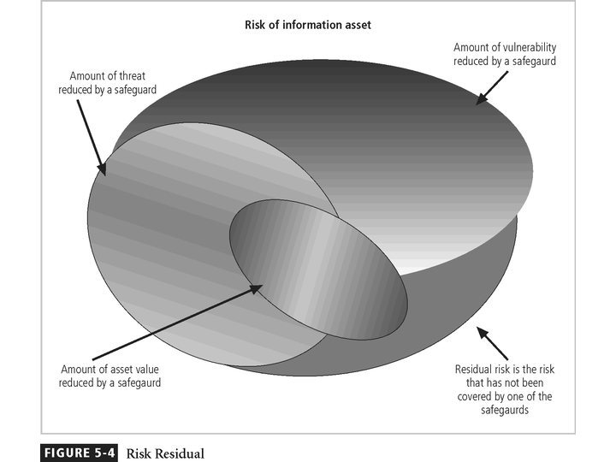
Principles of Information Security - Chapter 5
Slide <number>

Slide 40
Documenting Results
At minimum, each information asset-vulnerability pair should have a documented control strategy that clearly identifies any residual risk remaining after the proposed strategy has been executed
Some organizations document the outcome of the control strategy for each information asset-vulnerability pair as an action plan
This action plan includes concrete tasks, each with accountability assigned to an organizational unit or to an individual
Principles of Information Security - Chapter 5
Slide <number>
Notes:
Documenting Results
At minimum, each information asset-vulnerability pair should have a documented control strategy that clearly identifies any residual risk remaining after the proposed strategy has been executed.
Some organizations document the outcome of the control strategy for each information asset-vulnerability pair as an action plan.
This action plan includes concrete tasks, each with accountability assigned to an organizational unit or to an individual.

Slide 41
Recommended Practices in Controlling Risk
We must convince budget authorities to spend up to the value of the asset to protect a particular asset from an identified threat
Each and every control or safeguard implemented will impact more than one threat-asset pair
Principles of Information Security - Chapter 5
Slide <number>
Notes:
Recommended Practices in Controlling Risk
Select Safeguards Based On Expenditures
We must convince budget authorities to spend up to the value of the asset to protect a particular asset from an identified threat.
Each and every control or safeguard implemented will impact more than one threat-asset pair.
Between the impossible task associated with the valuation of information assets, and the dynamic nature of the ALE calculations, it’s no wonder organizations are looking for a more straightforward method of implementing controls, that doesn’t involve such imperfect calculations.

Slide 42
Qualitative Measures
The spectrum of steps described above was performed with real numbers or best-guess estimates of real numbers - this is known as a quantitative assessment
However, an organization could determine that it couldn’t put specific numbers on these values
Fortunately, it is possible to repeat these steps using estimates based on a qualitative assessment
Instead of using specific numbers, ranges or levels of values can be developed simplifying the process
Principles of Information Security - Chapter 5
Slide <number>
Notes:
Qualitative Measures
The spectrum of steps described above was performed with real numbers or best-guess estimates of real numbers. This is known as a quantitative assessment.
However, an organization could determine that it couldn’t put specific numbers on these values. Fortunately, it is possible to repeat these steps using estimates based on a qualitative assessment.
Instead of using specific numbers, ranges or levels of values can be developed simplifying the process.

Slide 43
Delphi Technique
One technique for accurately estimating scales and values is the Delphi Technique
The Delphi Technique, named for the Oracle at Delphi, is a process whereby a group of individuals rate or rank a set of information
The individual responses are compiled and then returned to the individuals for another iteration
This process continues until the group is satisfied with the result
Principles of Information Security - Chapter 5
Slide <number>
Notes:
Delphi Technique
How do you calculate the values and scales of either qualitative or quantitative assessment? One technique for accurately estimating scales and values is the Delphi Technique.
The Delphi Technique, named for the Oracle at Delphi, is a process whereby a group of individuals rate or rank a set of information.
The individual responses are compiled and then returned to the individuals for another iteration.
This process continues until the group of individuals is satisfied with the result.

Slide 44
Evaluation, Assessment, and Maintenance of Risk Controls
Once a control strategy has been implemented, the effectiveness of controls should be monitored and measured on an ongoing basis to determine the effectiveness of the security controls and the accuracy of the estimate of the residual risk
Principles of Information Security - Chapter 5
Slide <number>
Notes:
Evaluation, Assessment and Maintenance of Risk Controls
Once a control strategy has been implemented, the effectiveness of controls should be monitored and measured on an ongoing basis to determine the effectiveness of the security controls and the accuracy of the estimate of the residual risk.

